Slide 1
Efficient Methods in Machine Learning
Group Wassss - Aftab, Sauryan, Bruno – final presentation - 29.01.2025

Slide 2
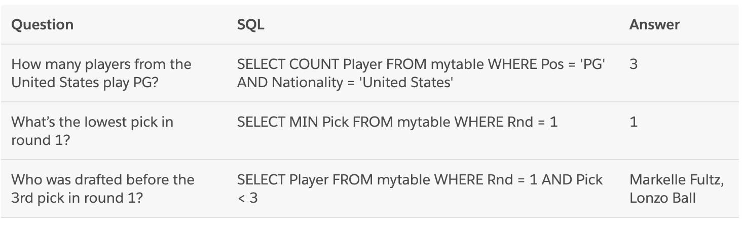
Dataset: WikiSQL
Task: Text to sql
80654 samples …
… using 24241 Wikipedia tables
Queries created algorithmically from the tables
Corresponding questions created using Amazon Mechanical Turk
Notes:
On the right: How does a sample look?

Slide 3
WikiSQL issues
Lots of weird and wrong data
Wrong aggregators
Weird queries
Even the generated queries are wrong
<= and => were converted to < and >
About 10% of test queries return None
Notes:
On the right: Examples for each of the issues
Conversion probably to simplify task. Issue is that the value that is being compared is always a value that actually exists in the column

Slide 4
Preprocessing
Turn canonical representations into human readable form
Concatenate question and table header
No filtering
Notes:
Question may not use proper column, for example “Which country …” but the column name is “member state” -> header into input (image on the right)
Filtering: Didn’t want to make task easier; Outlier removal didn’t improve anything; Filtering out wrong data is difficult because 1 requires looking at the table, 2 requires another LLM and makes comparison to state-of-the-art difficult

Slide 5
Pipeline
Preprocessing
More secret preprocessing
Tokenization (BPE)
Inference (T5 generation)
Detokenization
Secret postprocessing
Postprocessing (Optional)
Notes:
Postprocessing: Turn query output into canonical form for detailed metrics and to execute on sql database

Slide 6
T5 Transformer Model
“Text-to-Text Transformer”
Encoder-Decoder architecture
Shared embedding layer
Relative positional “embeddings” via modified self-attention
Notes:
Postprocessing: Turn query output into canonical form for detailed metrics and to execute on sql database

Slide 7
The Numbers
Configuration | google/efficient-tiny | ours
Encoder layers | 4 | 4
Decoder layers | 4 | 4
Number of Heads | 4 | 4
Embedding dimension | 256 | 128
Feed-Forward dimension | 1024 | 32
Q, K, V, O dimension | 64 | 32
Vocabulary size | 32.100 | 512
Total | 15.570.688 | 986.112
Notes:
Postprocessing: Turn query output into canonical form for detailed metrics and to execute on sql database

Slide 8
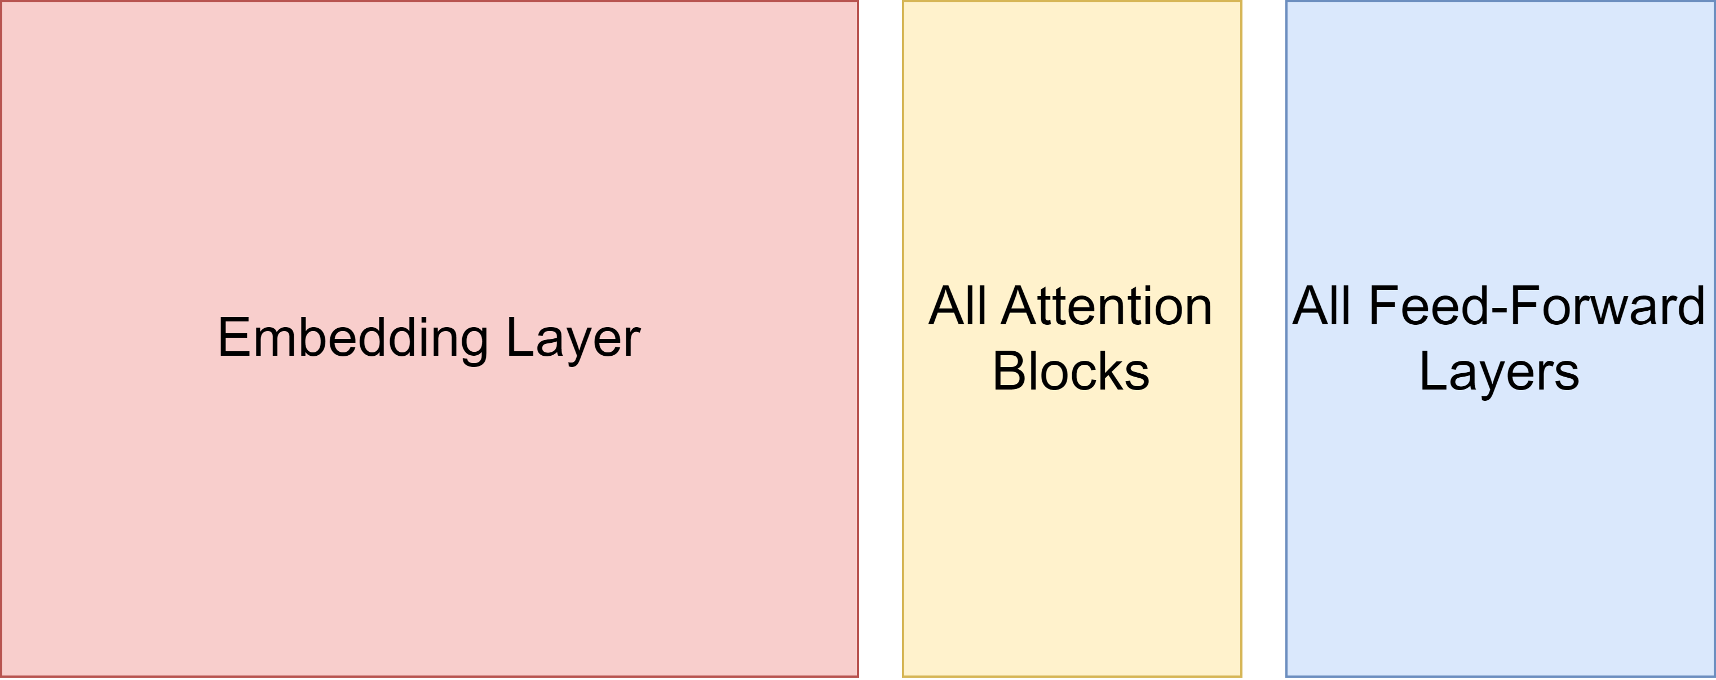
3.158.016
4.204.544
32.100 * 256 = 8.217.600
4 * (256*256 + 256) * (4 + 8)
(2 * 256 * 1024 + 256 + 1024) * 8
Notes:
Postprocessing: Turn query output into canonical form for detailed metrics and to execute on sql database

Slide 9
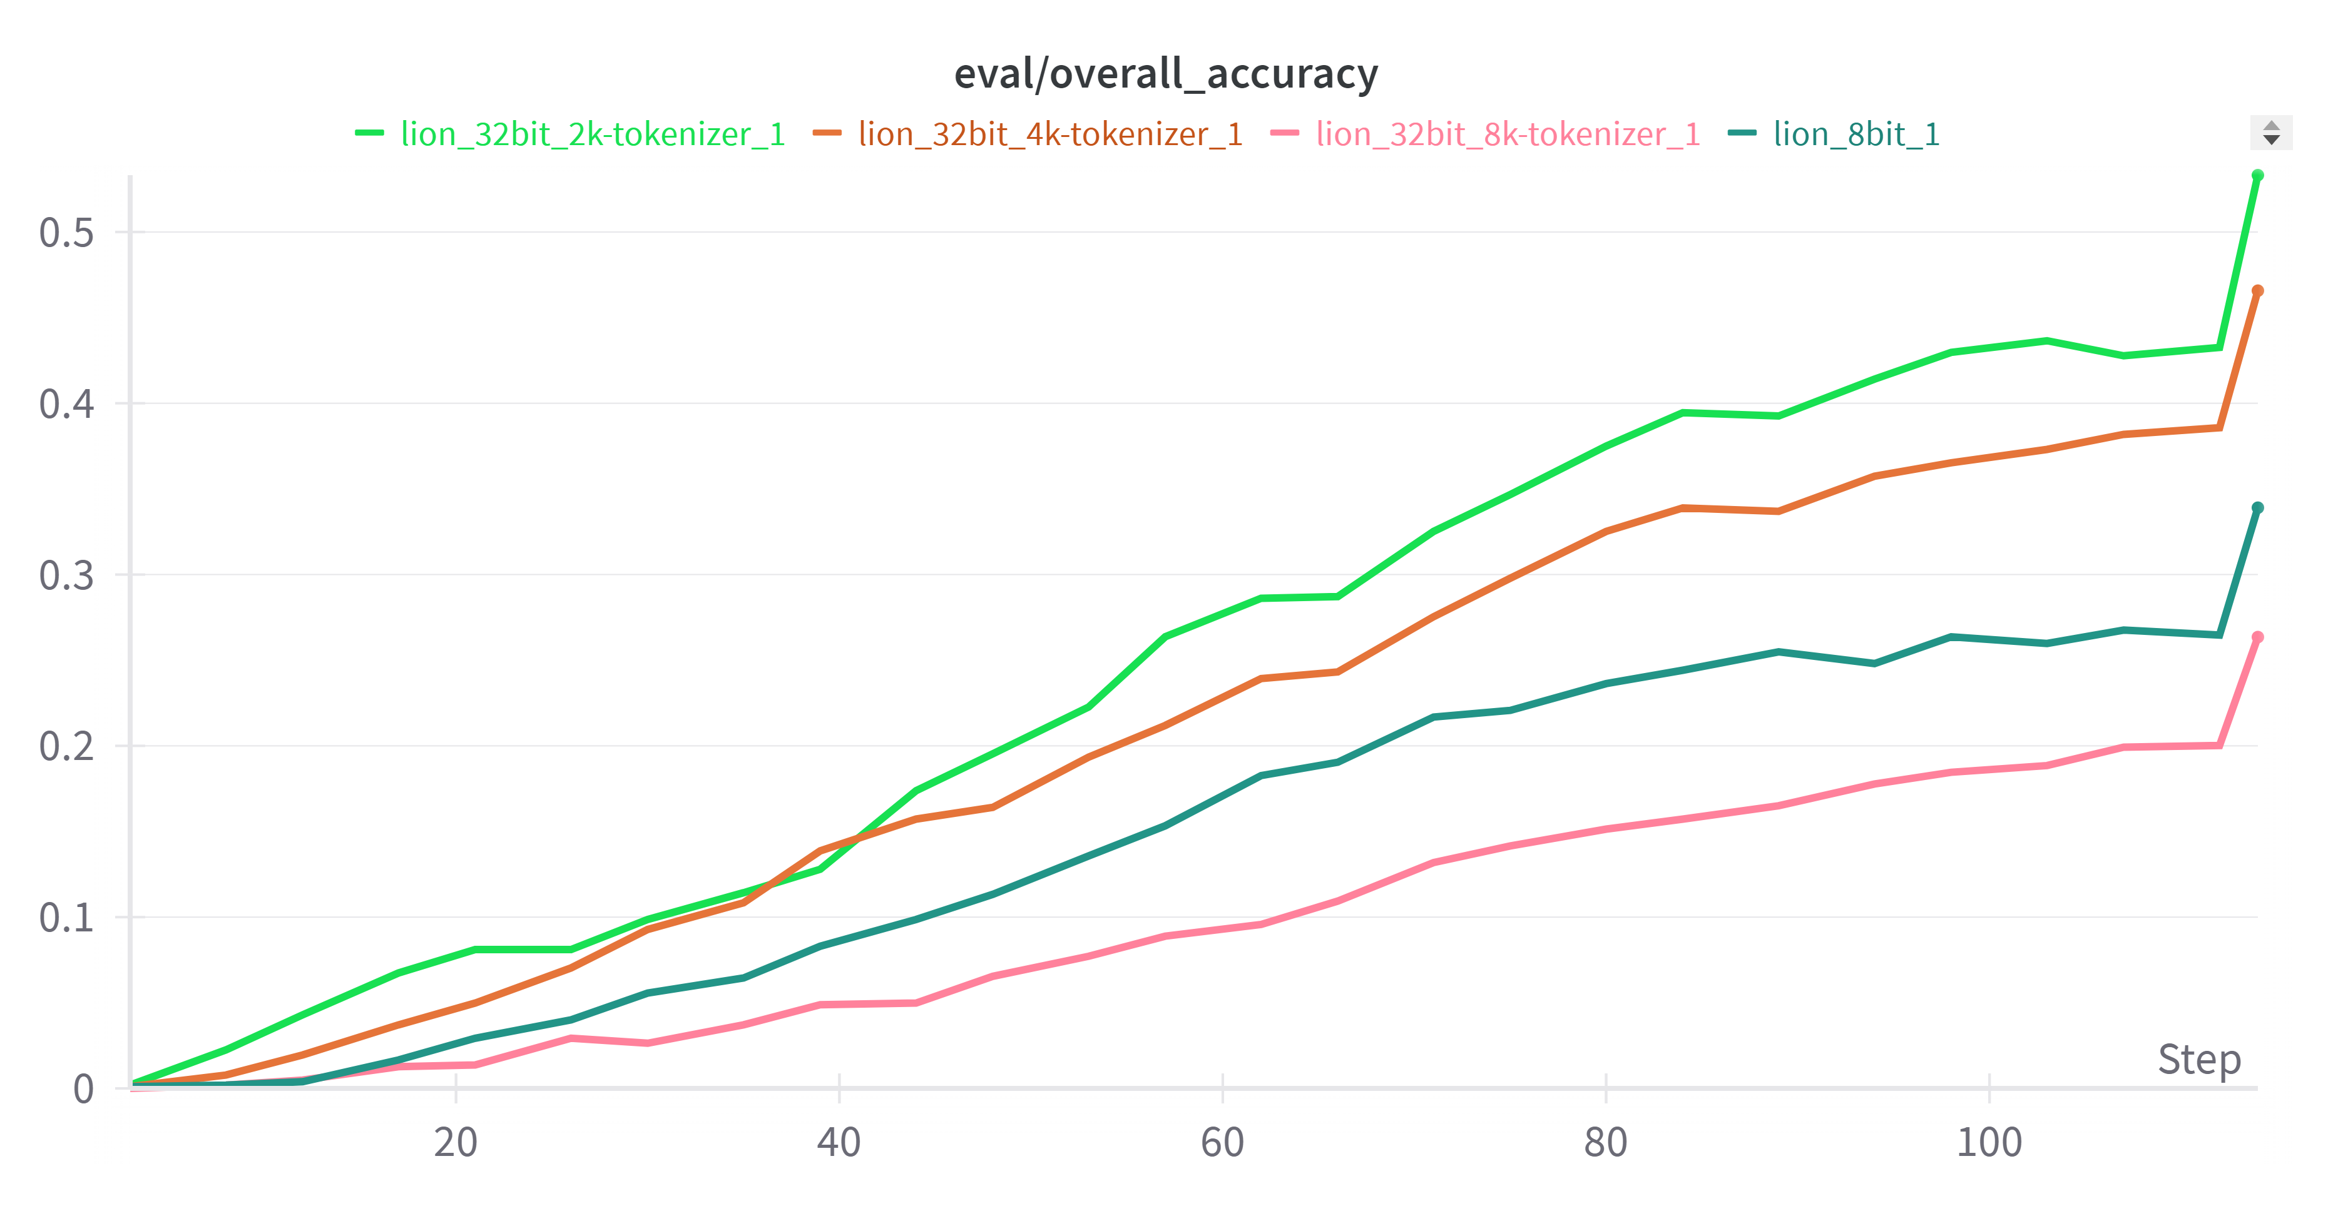
Evaluation
Notes:
Plotted is accuracy
Don’t get confused by the little dent at the end
Baseline in blue; 16k tokenizer so bad I deleted it
8k still worse than 32k; threw us off
BPE and unigram almost the same; BPE seemed a tiny bit more stable Can’t shrink further because dataset contains 1.700 characters, so we actually are only left with 300 effective tokens

Slide 10
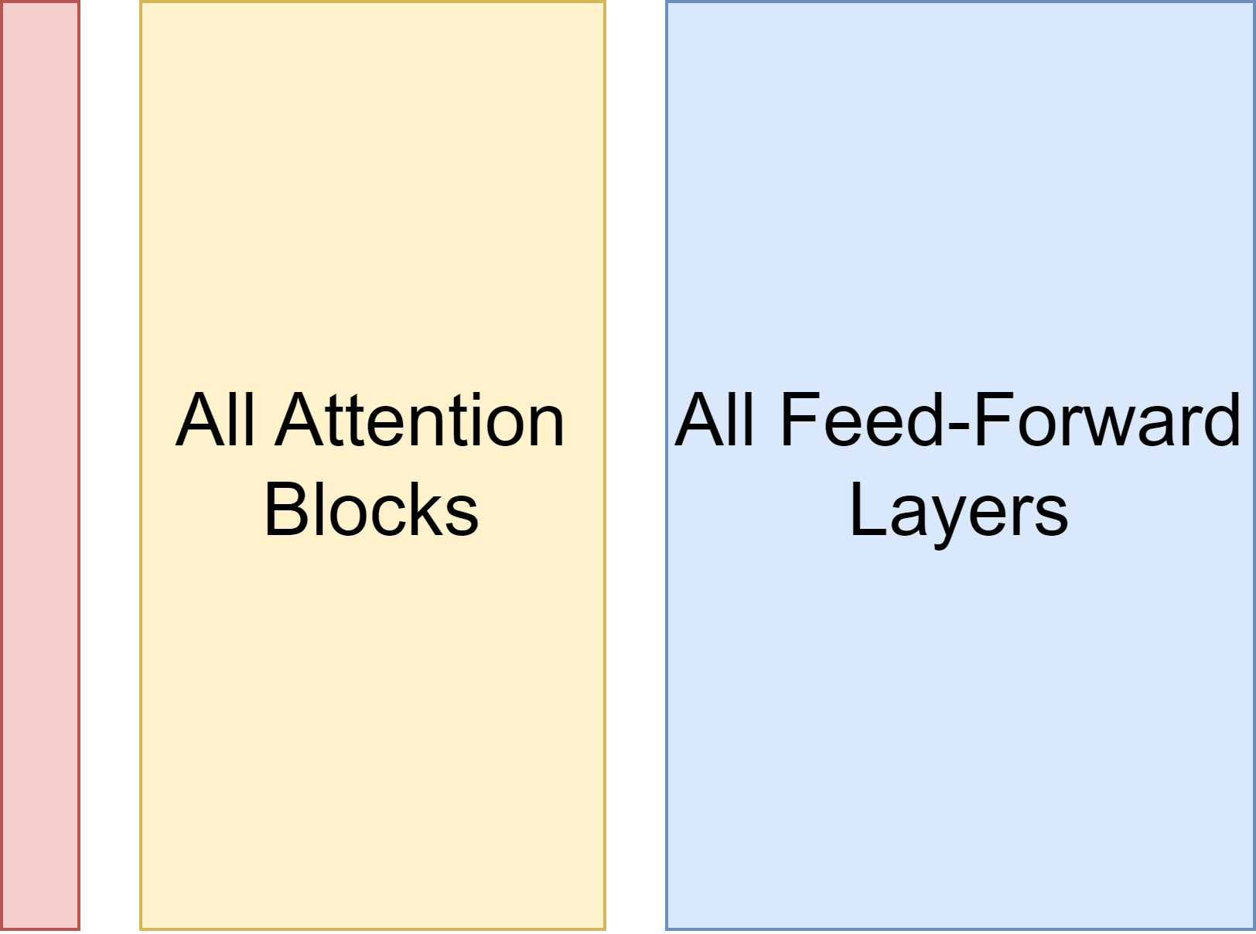
Evaluation
3.158.016
4.204.544
2048 * 256 = 524.288
4 * (256*256 + 256) * (4 + 8)
(2 * 256 * 1024 + 256 + 1024) * 8
Notes:
This is how the parameter distribution looks now. Now any sensible person would start looking at one of the big blocks; I couldn’t let the 1700 characters taking up tokens go

Slide 11
Evaluation
'What is the hangul symbol for the hanja 良州?'
'What is the hangul symbol for the hanja [MAP]0[/MAP][MAP]1[/MAP]?
Notes:
So what I ended up doing is defining a character coverage and replacing all tokens outside of it with special tokens and an id

Slide 12
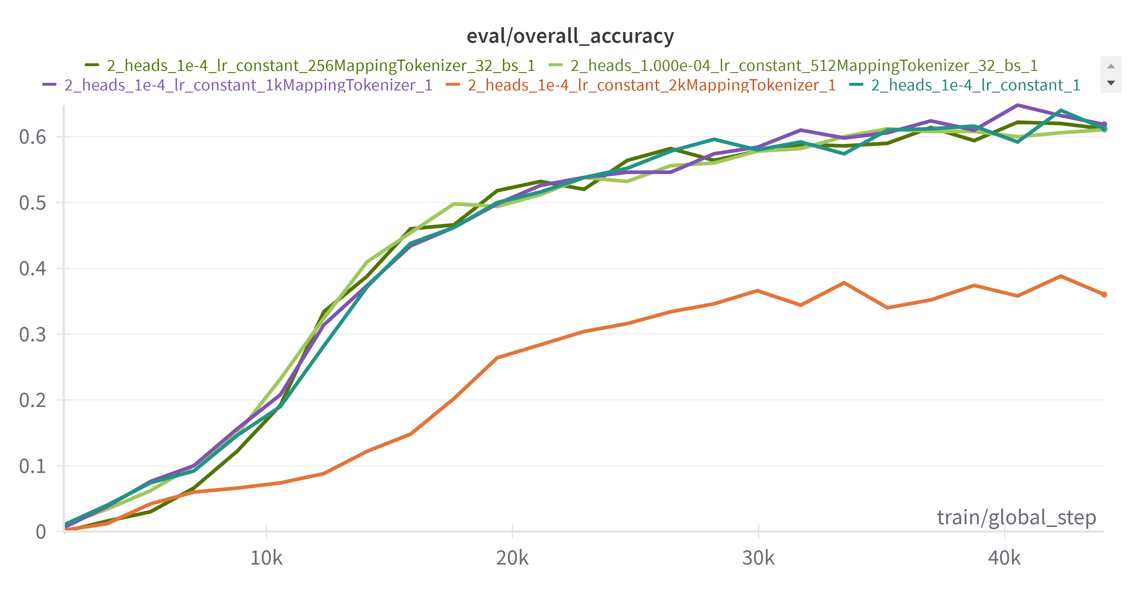
Evaluation
Notes:
Plotted is accuracy
Don’t get confused by the little dent at the end
Baseline in blue; 16k tokenizer so bad I deleted it
8k still worse than 32k; threw us off Can’t shrink further because dataset contains 1.700 characters, so we actually are only left with 300 effective tokens

Slide 13
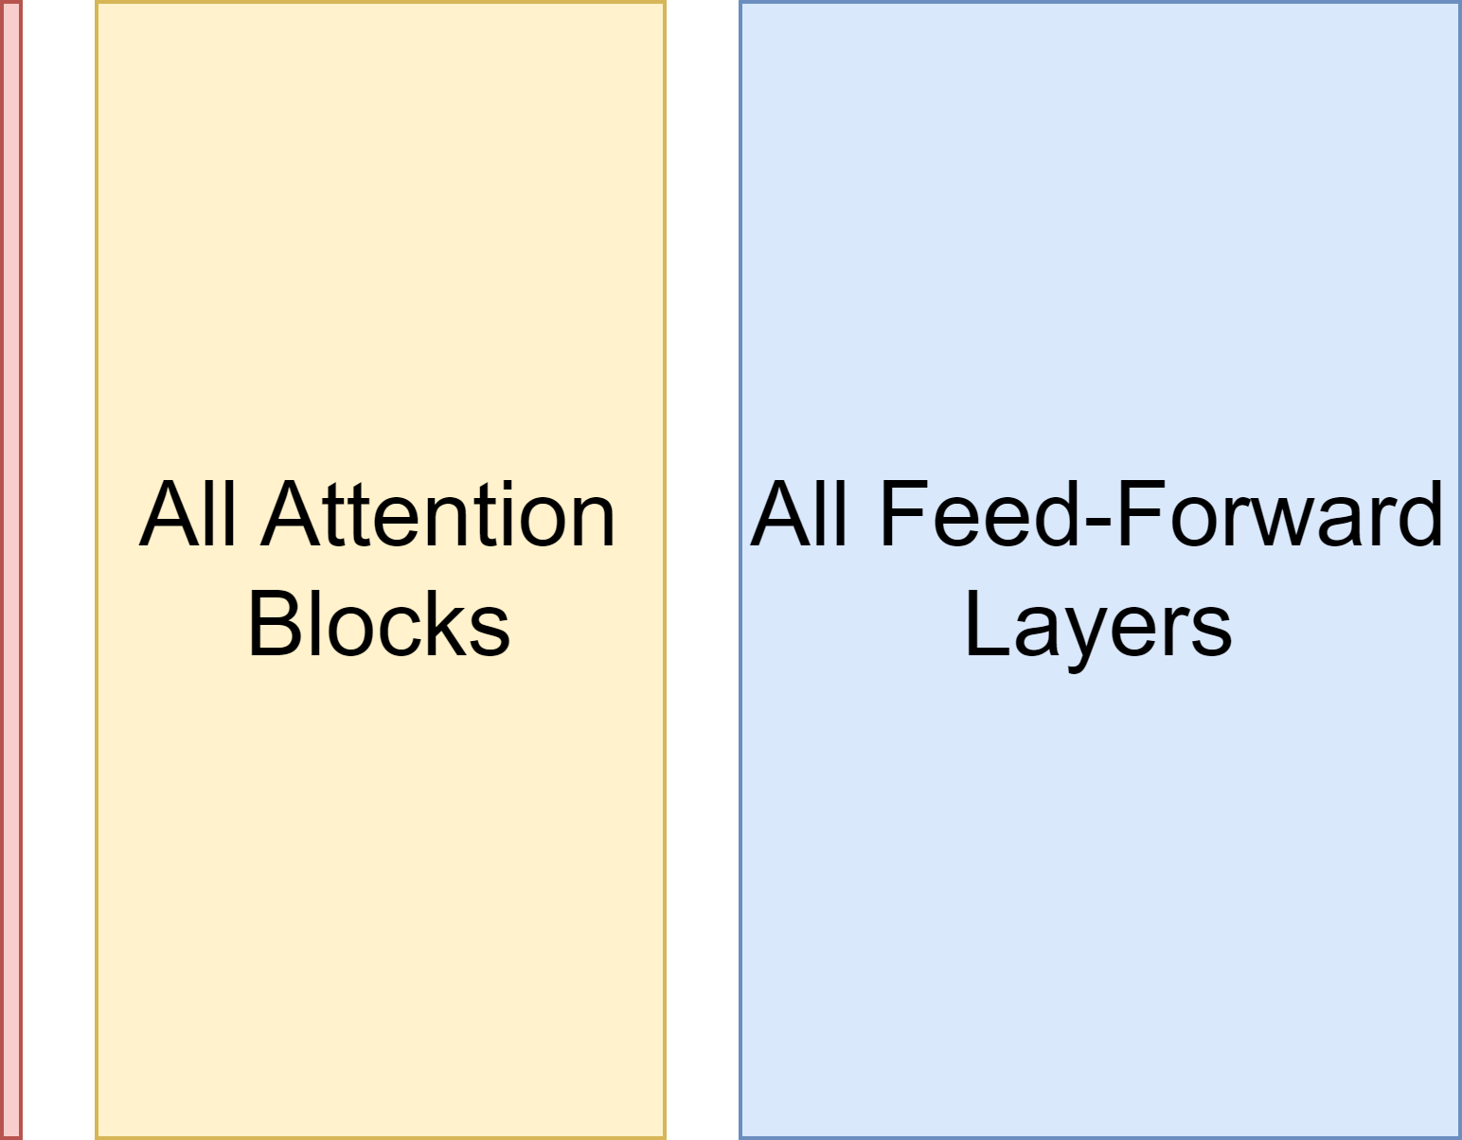
Evaluation
3.158.016
4.204.544
512 * 256 = 131.072
4 * (256*256 + 256) * (4 + 8)
(2 * 256 * 1024 + 256 + 1024) * 8
Notes:
This is how the parameter distribution looks now. Now it’s less clear where the most potential is but we actually had a theory from the very beginning.
Grammar vs facts; Fact Finding: Attempting to Reverse-Engineer Factual Recall on the Neuron Level

Slide 14
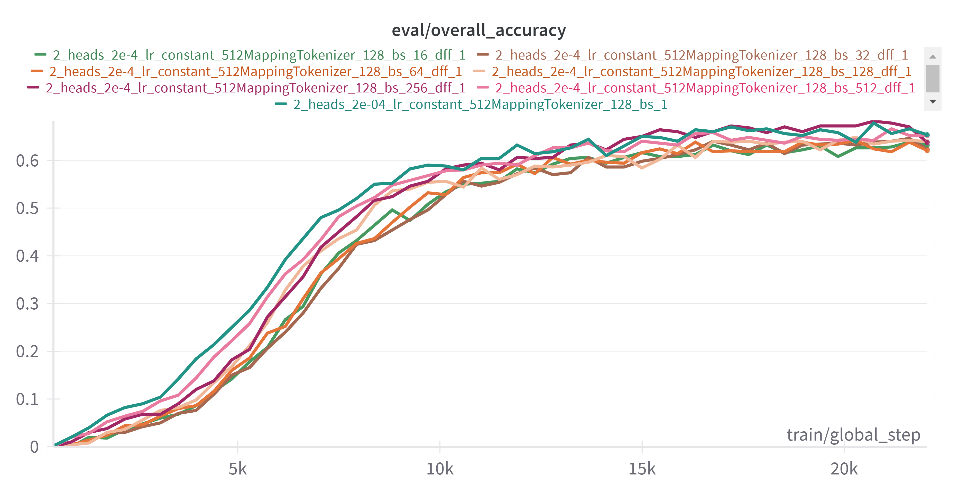
Evaluation

Slide 15
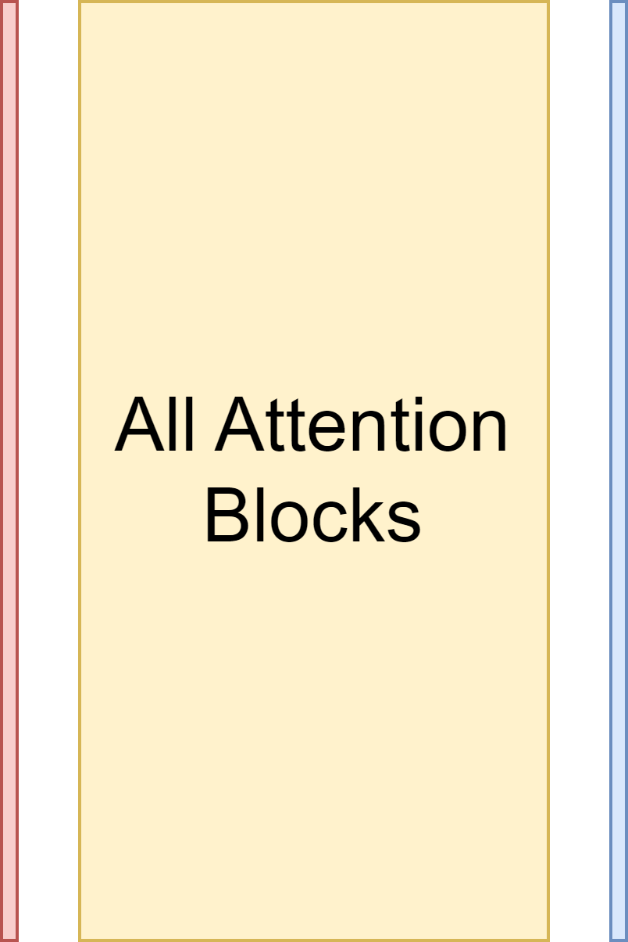
Evaluation
3.158.016
512 * 256 = 131.072
4 * (256*256 + 256) * (4 + 8)
(2 * 256 * 32) * 8 ~ 133.376

Slide 16
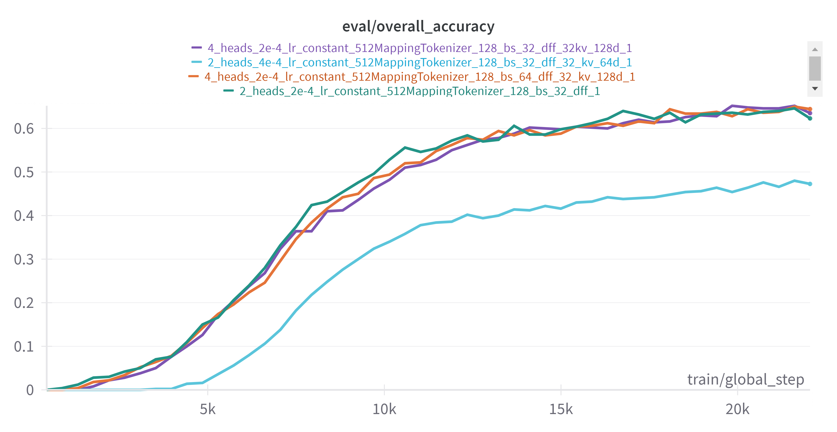
Evaluation
Notes:
Baseline in blue dim from 256 to 128

Slide 17
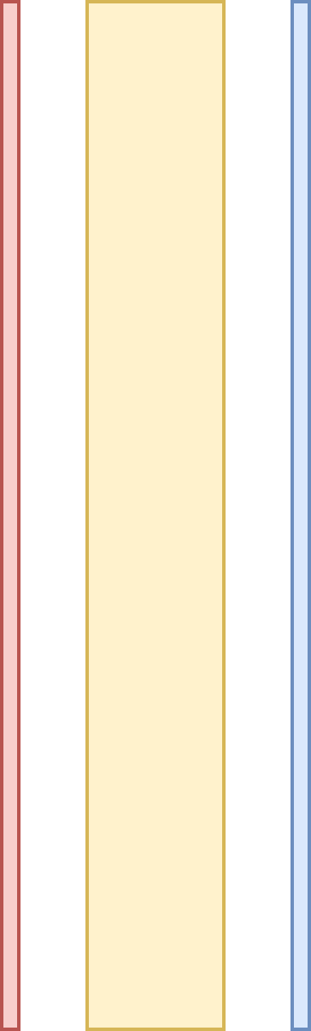
Evaluation
512 * 128 = 65.536
4 * (128*128 + 128) * (4 + 8) = 792.576
(2 * 128 * 32) * 8 ~ 66.816

Slide 18
Training optimization
Lion seemed slightly better than adam
Learning rate schedule: constant > cosine restarts > linear
Batch-size of 128 converged slower but slightly higher than 64 and 32

Slide 19
Evaluation optimization
5 beams (+0.7%)
Allow arbitrary order of conditions (+0.3%)
Correct output query using distance metric (Levenshtein +1.8%; LCS +2.1%)
Notes:
LCS: Longest Common Subsequence

Slide 20
What didn’t work?
Number of heads didn’t change much (d_kv * heads = d_model)
Reducing the number of layers impacted accuracy
Notes:
I showed everything that worked; what didn’t work?
Design rule -> same parameters (apart from biases)

Slide 21
DEMO

Slide 22
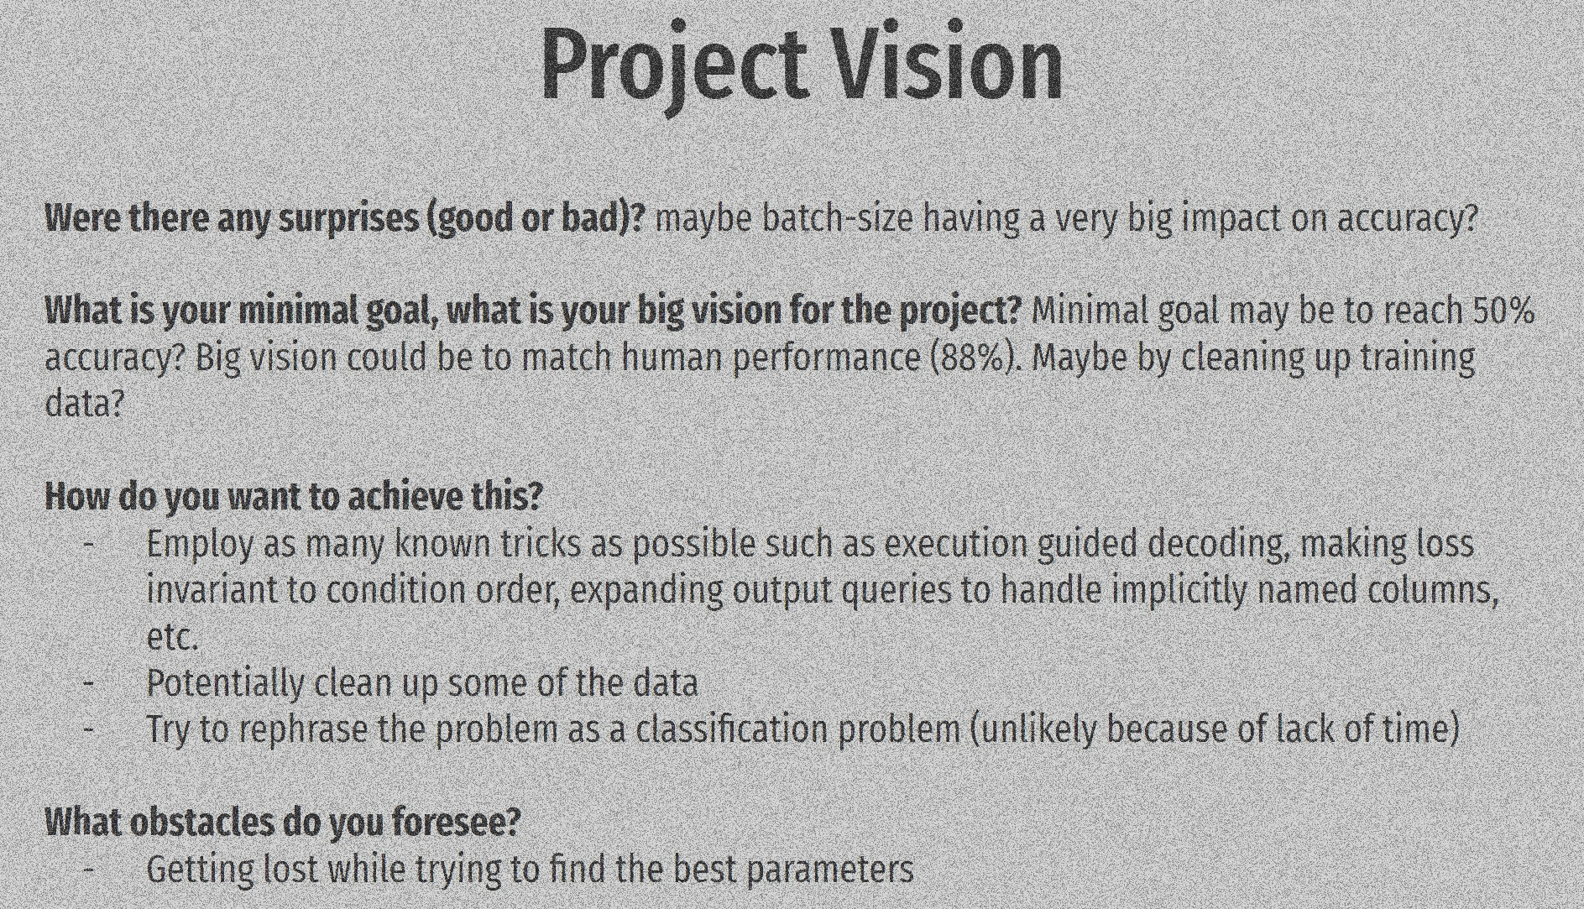
Expectation vs Reality
Notes:
Throwback to a very long time ago

Slide 23
Surprises/Learnings
Smaller tokenizer does not mean faster training
If it’s too good to be true, you messed up
Self-attention to MLP ratio has huge potential for optimization
Heads are surprisingly irrelevant
Batch-size and learning rate are closely related but nobody knows what that relation is
Lion Optimizer’s recommended parameters aren’t good?
Huggingface parameter ‘predict_with_generate’ is crucial for performance
Huggingface is a French company doing French things
Notes:
Smaller tokenizer: Probably fast either way; More tokens + quadratic scaling
Learning rate: Theory says square root; practical recommendations say linear (this is default param), maybe weight decay?; for us linear didn’t work at all; square root worked fine but probably very optimizable
Lion: beta2 0.99 is significantly worse than 0.999 Huggingface: Horrible documentation; resuming training doesn’t work; Lead dev is a ChatGPT Bot

